Slide 1
Constructing Committing and Leakage-Resilient Authenticated Encryption
Patrick Struck and Maximiliane Weishäupl

Slide 2
Motivation: Why Committing Security?
Partitioning oracle attack [LGR21]:
$$K_{0}$$
$$K_{1}$$
$$K_{2}$$
$$K_{3}$$
$$K_{4}$$
$$K_{5}$$
$$K_{6}$$
$$K_{7}$$
$$K_{8}$$
$$K_{9}$$
Finds $N, C$, and $A$ such that:
$Dec\left(K_{0},N,A,C\right)≠ ⊥$ $Dec\left(K_{1},N,A,C\right)≠ ⊥Dec\left(K_{2},N,A,C\right)≠ ⊥Dec\left(K_{3},N,A,C\right)≠ ⊥Dec\left(K_{4},N,A,C\right)≠ ⊥$
$$Dec\left(K_{5},N,A,C\right)= ⊥$$
$$Dec\left(K_{6},N,A,C\right)= ⊥$$
$$Dec\left(K_{7},N,A,C\right)= ⊥$$
$$Dec\left(K_{8},N,A,C\right)= ⊥$$
$$Dec\left(K_{9},N,A,C\right)= ⊥$$
Decryption
error
$$C$$
$$K_{0}$$
$$K_{1}$$
$$K_{2}$$
$$K_{3}$$
$$K_{4}$$
$$K_{5}$$
$$K_{6}$$
$$K_{7}$$
$$K_{8}$$
$$K_{9}$$
Alice
Bob
$$K_{8}$$
$$K_{8}$$
Further attacks:
Fast message franking [DGRW18]
Subscribe with Google attack [ADG+22]
$$S_{1}$$
$$S_{2}$$

Slide 3
Motivation: Why Leakage Resilience?
Side-Channel Analysis (SCA):
SCA of AE schemes:
Power-analysis of Ascon and Keyak [SD17]
Power-analysis of Elephant [Via22]
Power-analysis of Ascon [WP23]
$$Enc\left(K,N,A,M\right)=C$$
Security against SCA formalized by the notion of leakage-resilient AE schemes
Alice
Bob
→ Until now: Committing security and leakage resilience have only been analyzed isolated, not in conjunction
→ Goal of this work: Constructing authenticated encryption with both properties

Slide 4
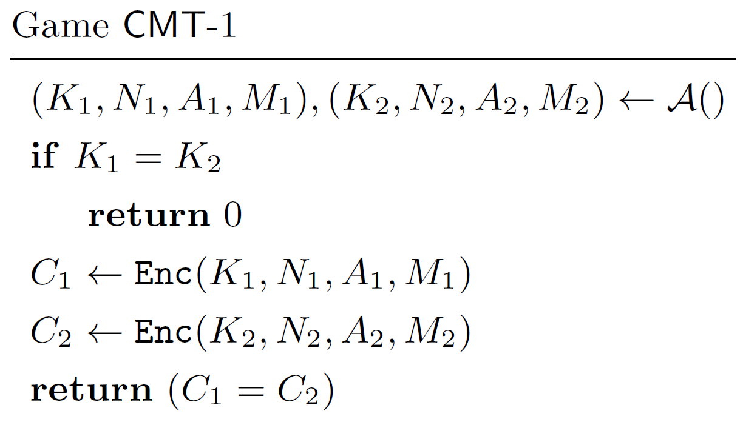
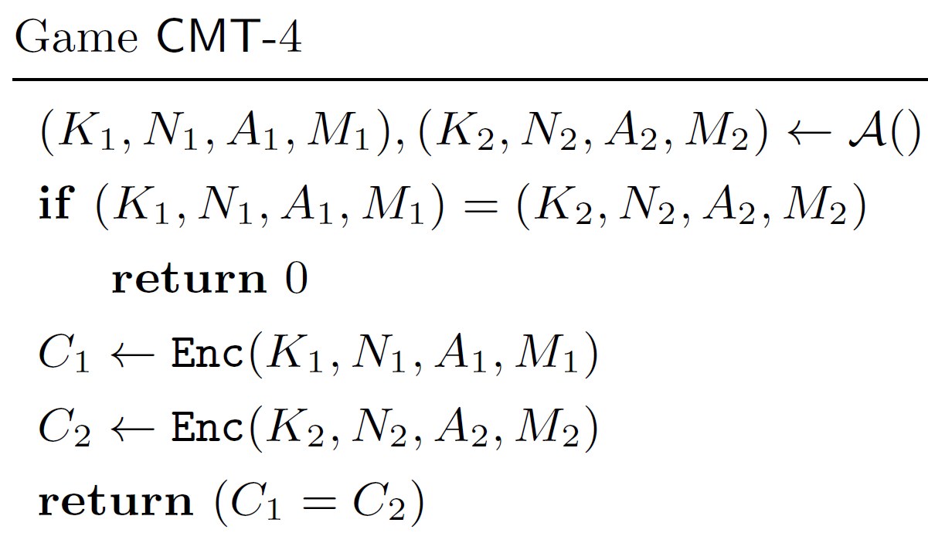
Definition: Committing Security
[ABN10]
[FLPQ13]
[FOR17]
[BH22]
[CR22]
[MLGR23]
Robustness for PKE
Robustness for AE
CMT Security for AE
More fine-grained notions
CMT-1, CMT-3 $⟺$ CMT-4
CMT

Slide 5
Definition: Leakage Resilience [BMOS17]
$$K$$
$$K,b$$
LEnc
LDec
Enc/$
Dec/⊥
Leakage Oracles
Challenge Oracles
$$X,L$$
$$Y,L(K,X)$$
$$Y$$
$$X$$
$$b′$$

Slide 6
First Approach: Generic Composition
Initially introduced in [BN00]
Refinement and definition for nonce-based AE in [NRS14]
Analysis of LAE security of the N-schemes in [BMOS17]
AE Scheme
Symmetric
Encryption (SE) Scheme
Message
Authentication Code (MAC)
N1 (Encrypt-and-MAC)
N2 (Encrypt-then-MAC)
N3 (MAC-then-Encrypt)
$$K_{e},N$$
$$C$$
SE
$$C$$
SE
$$C$$
$$M$$
MAC
$$T$$
$$M$$
SE
MAC
$$T$$
$$M$$
$$C$$
MAC
$$T$$
$$K_{m},N,A$$
$$K_{e}, N$$
$$K_{e}, N$$
$$K_{m}, N,A$$
$$K_{m}, N,A$$

Slide 7
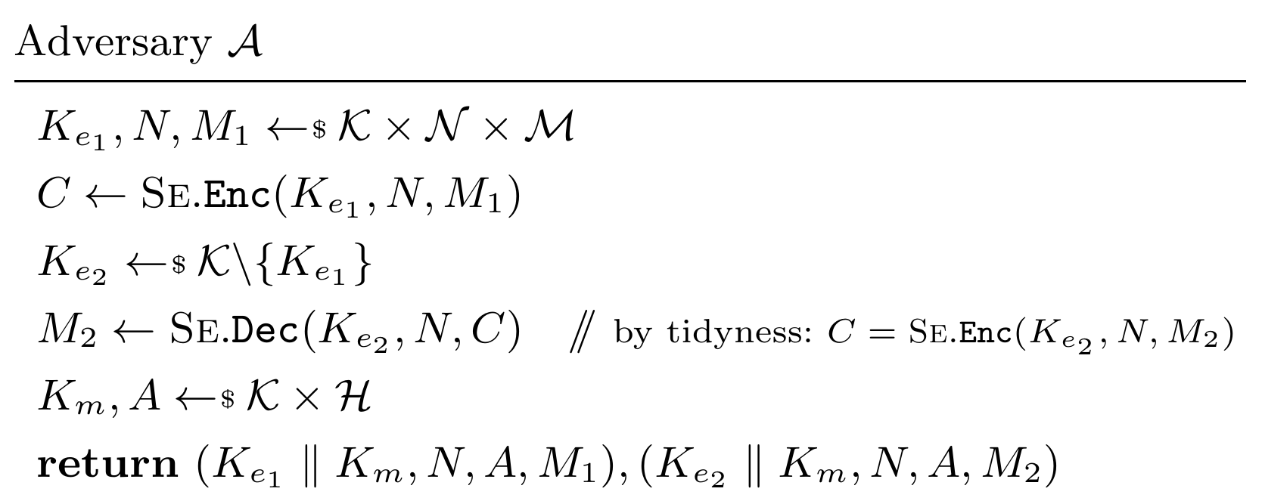
Committing Security of N2
N2 (Encrypt-then-MAC)
$$C$$
$$M$$
SE
MAC
$$T$$
$$C$$
$$K_{e}, N$$
$$K_{m}, N,A$$
Tidy encryption scheme:
$$∀\left(K,N,A,C\right)∈𝒦×𝒩×ℋ×𝒞:$$
$$Enc\left(K,N,A,Dec\left(K,N,A,C\right)\right)=C$$
$$C$$
$$C$$
$$M_{1}$$
SE
MAC
$$T$$
$$M_{2}$$
SE
MAC
$$T$$
$$C$$
$$C$$
$$K_{e_{1}}, N$$
$$K_{m}, N,A$$
$$K_{e_{2}}, N$$
$$K_{m}, N,A$$

Slide 8
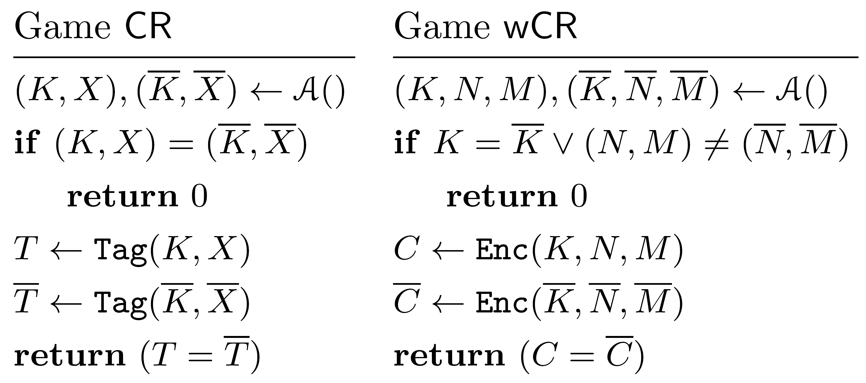
Committing Security of N1
N1 (Encrypt-and-MAC)
$$K_{e},N$$
SE
$$C$$
$$M$$
MAC
$$T$$
$$K_{m}, N,A$$
Are there any SE schemes and MACs that fulfill these properties?
→ Yes, SLAE [DJS19]

Slide 9
Conclusion: Generic Composition Approach
N1 (Encrypt-and-MAC)
N2 (Encrypt-then-MAC)
N3 (MAC-then-Encrypt)
LAE
[BMOS17]
CMT
[this work]
One cannot achieve CMT and LAE security at the same time from generic composition!

Slide 10
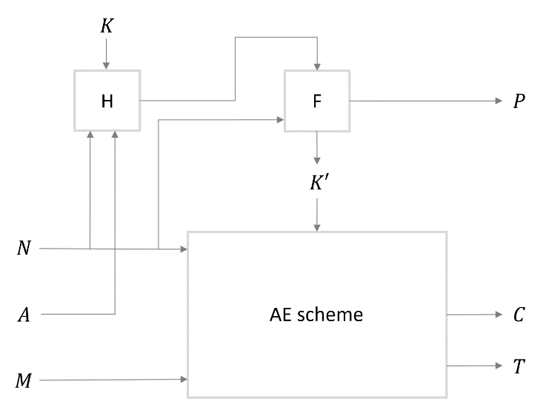
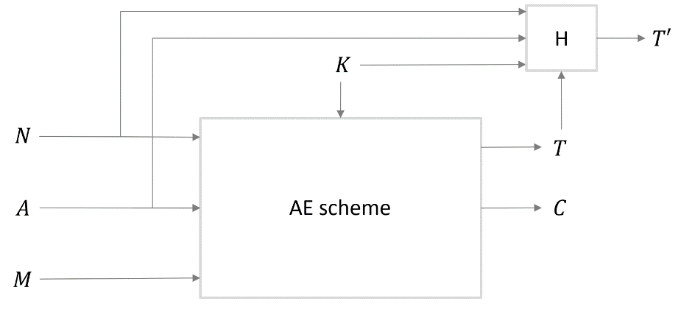
Second Approach: A Generic Transformation
Existing transformations that achieve committing security:
$\text{HtE}∘$ UtC [BH22]
CTX [CR22]
PaddingZeros [ADG+22]
KeyHashing [ADG+22]
Is LR preserved?
CMT security
CTX
$\text{HtE}∘$ UtC
CMT-1 security
→ both transformations hash the key
→ if H leaks the key, LAE security is not given
Goal: Develop a transformation that achieves both CMT and LAE security.

Slide 11
The UtC*-Transform (I)
H hash function
F keyed function
$$K$$
$$X$$
H
F
$$P$$
$$K′$$
$$N$$
$$A$$
AE scheme
$$C$$
$$T$$
$$M$$

Slide 12
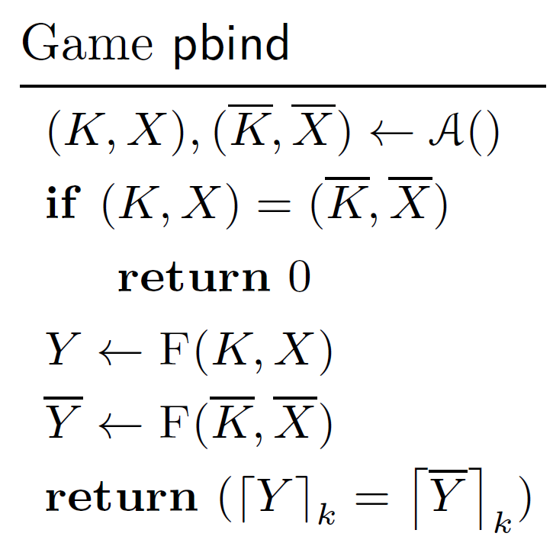
The UtC*-Transform (II)
We show:
The UtC*-transform yields a CMT-secure scheme:
The UtC*-transform yields an LAE-secure scheme:
Collision resistance
$$ℒ=ℒ_{H}{×ℒ}_{F}×ℒ_{AE}$$
q = # queries to challenge oracles
Collision resistance
Standard AE security

Slide 13
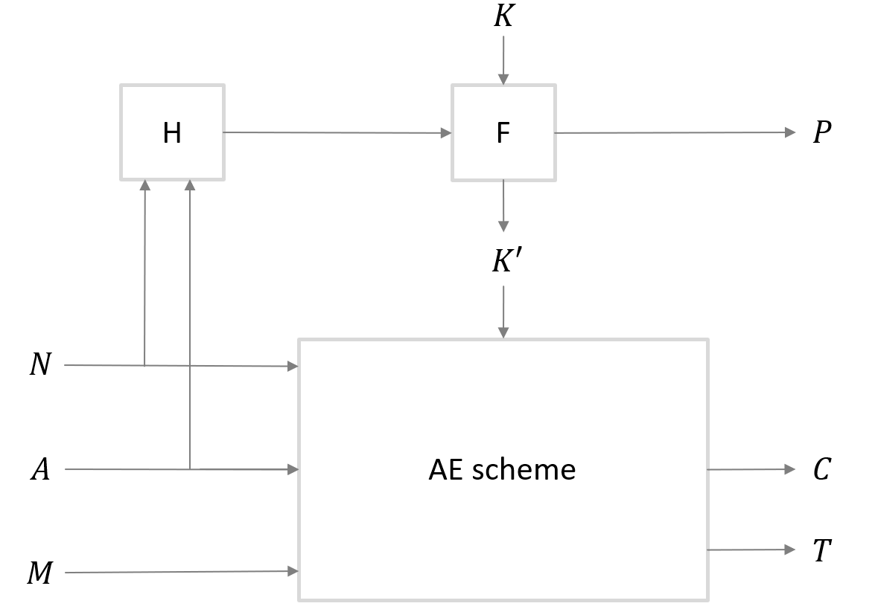
Thank you for listening! Any questions?
Conclusion
ePrint 2024/190
maximiliane.weishaeupl@ur.de

Slide 14
References
[ABN10] Abdalla, Bellare, Neven. Robust Encryption. TCC 2010.
[ADG+22] Albertini, Duong, Gueron, Kölbl, Luykx, and Schmieg. How to abuse and fix authenticated encryption without key commitment. USENIX Security 2022.
[BH22] Bellare and Hoang. Efficient schemes for committing authenticated encryption. EUROCRYPT 2022.
[BMOS17] Barwell, Martin, Oswald, and Stam. Authenticated encryption in the face of protocol and side channel leakage. ASIACRYPT 2017.
[BN00] Bellare and Namprempre. Authenticated encryption: Relations among notions and analysis of the generic composition paradigm. ASIACRYPT 2000.
[CR22] Chan and Rogaway. On committing authenticated-encryption. ESORICS 2022.
[DGRW18] Dodis, Grubbs, Ristenpart, and Woodage. Fast message franking: From invisible salamanders to encryptment. CRYPTO 2018.
[DJS19] Degabriele, Janson, and Struck. Sponges resist leakage: The case of authenticated encryption. ASIACRYPT 2019.
[FLPQ13] Farshim, Libert, Paterson, and Quaglia. Robust Encryption, Revisited. PKC 2013.
[FOR17] Farshim, Orlandi, and Roşie. Security of symmetric primitives under incorrect usage of keys. IACR Trans. Symm. Cryptol.,
[LGR21] Len, Grubbs, and Ristenpart. Partitioning oracle attacks. USENIX Security 2021.
[MLGR23] Menda, Len, Grubbs, and Ristenpart. Context discovery and commitment attacks - how to break CCM, EAX, SIV, and more. EUROCRYPT 2023.
[NRS14] Namprempre, Rogaway, and Shrimpton. Reconsidering generic composition. EUROCRYPT 2014.
[SD17] Samwel and Daemen. DPA on hardware implementations of Ascon and Keyak. Computing Frontiers Conference 2017.
[Via22] Vialar. Fast Side-Channel Key-Recovery Attack against Elephant Dumbo. Cryptology ePrint Archive, Paper 2022/446.
[WP23] Weissbart and Picek. Lightweight but Not Easy: Side-channel Analysis of the Ascon Authenticated Cipher on a 32-bit Microcontroller. Cryptology ePrint Archive, Paper 2023/1598.

